Slide 1


VAN NUYS
Resiliency Plan
CSUN Masters of Urban Planning

Slide 2

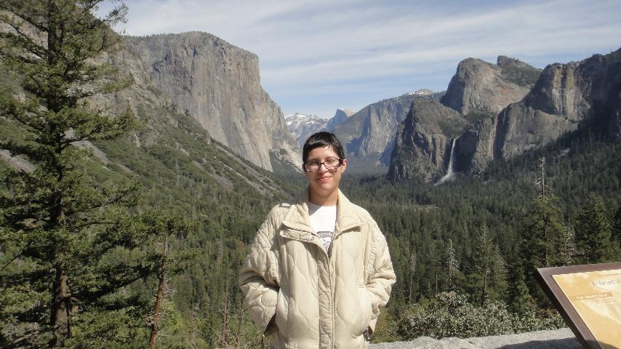

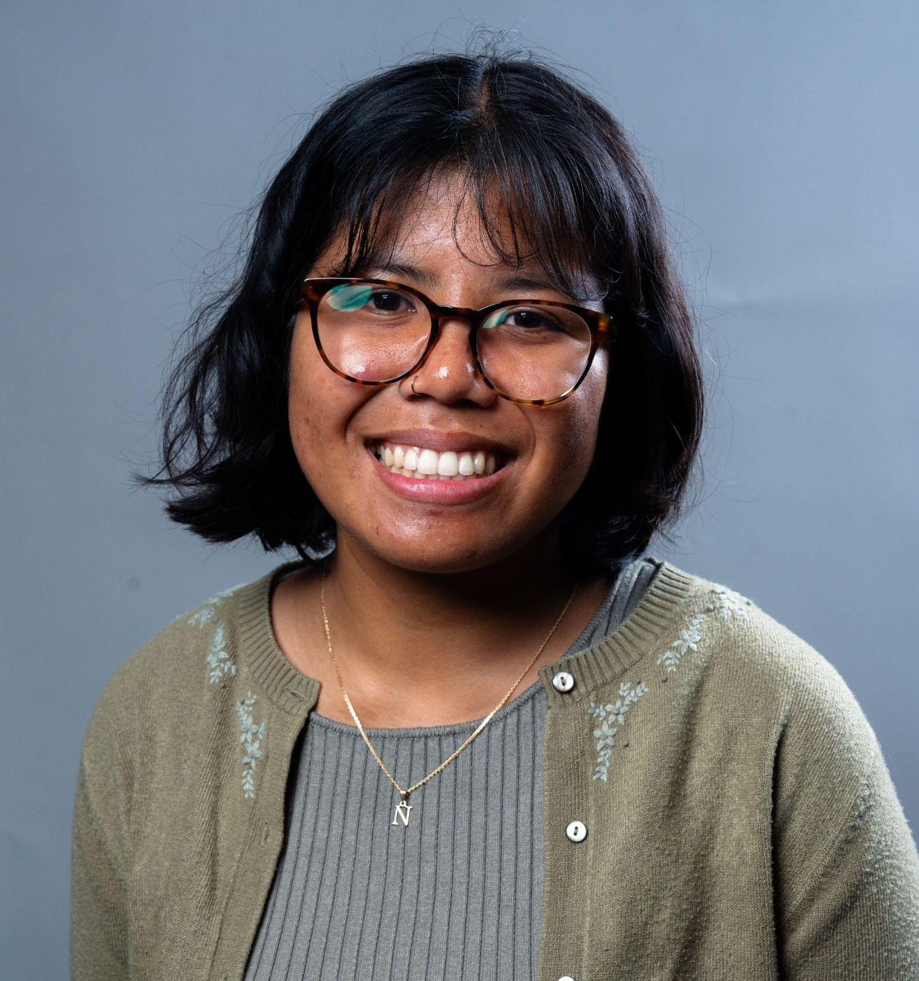
About the Program
The Master of Urban Planning (MUP) provides a broad-based education in urban planning, especially as it is practiced in the State of California. Classroom experience emphasizes key theoretical aspects of urban planning, while practical exercises and field experiences address how planning problems are tackled at the local and regional levels.
The 36-unit master’s degree in urban planning is designed to be completed in two calendar years.
The degree program is cohort driven with new class cohorts beginning each year in the fall semester.
Sarah Pando
Andrew Somers
Nurjannah Wiryadimejo
2nd-Year MUP Student
2nd-Year MUP Student
2nd-Year MUP Student

Slide 3


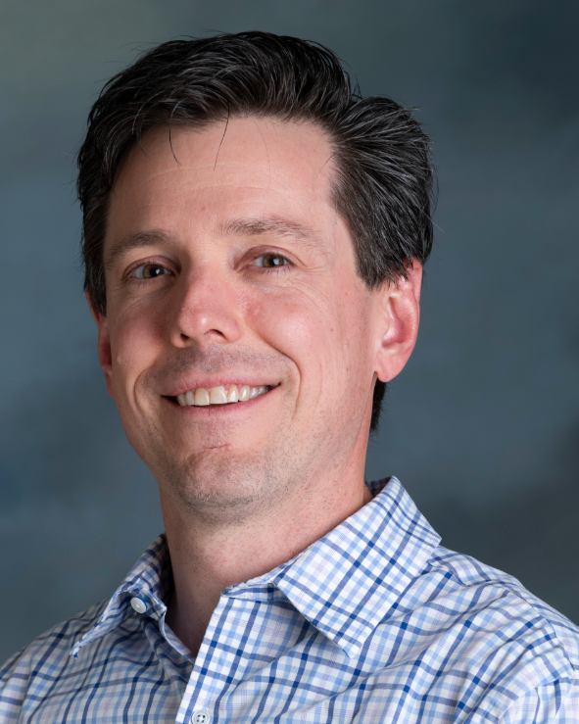
Graduate Advisors
Area of expertise
Urban transportation planning, sustainable mobility, and the connections between transport, equity, and quality of life.
Area of expertise
Analytical methods, economic development, environmental and resilience planning
Dr. Mintesnot Woldeamanuel
Dr. Craig T. Olwert

Slide 4
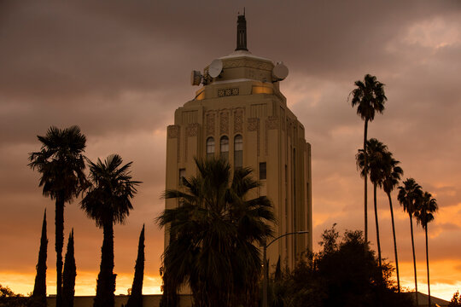
Our project this year will center on the Van Nuys Community to design their own resiliency plan.
This project will be developed during the Fall and Spring Semesters.
Currently, we are in the Field Project course. By the end of the class, we will have a clear project direction and have gathered research by conducting interviews, surveys, and hosting community events.
During the Professional Project course in the Spring we will utilize this research, refine our project, and prepare the final plan.

Slide 5
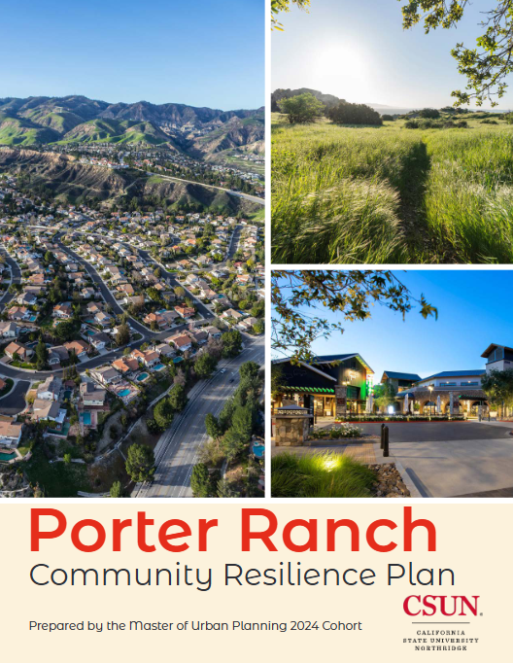
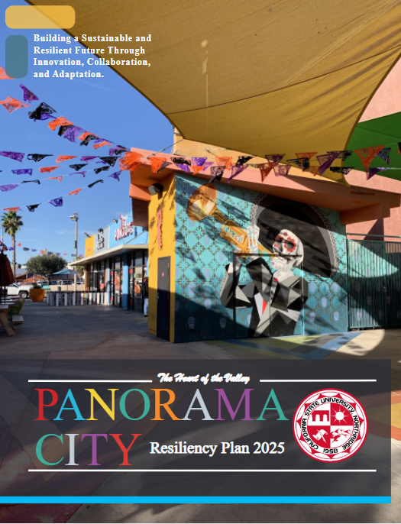
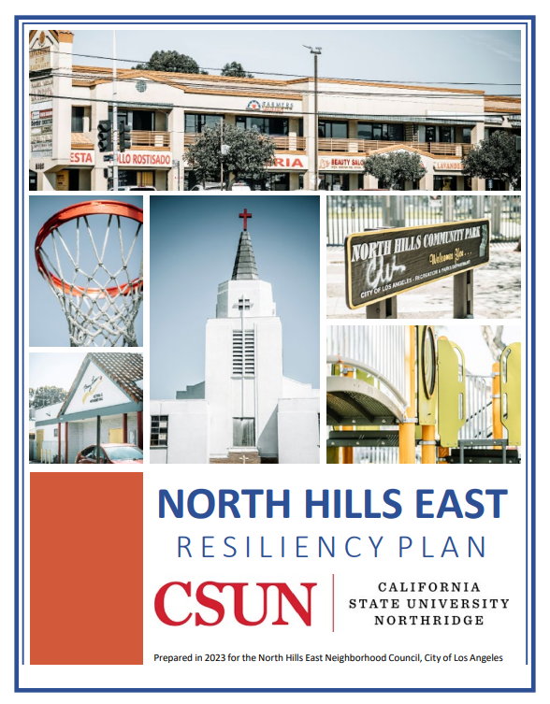
What is a Resilience Plan?
Resiliency planning refers to proactive and strategic approaches to managing and adapting to potential risks, shocks, and disruptions. Oconnel (2023)
Natural Disasters: Earthquakes, Fires, etc.
Technological Hazards: Infrastructure failures, Industrial Accidents, etc.
Social and Economic Vulnerabilities: Poverty and Inequality, Inadequate Healthcare Oconnel (2023)
Resiliency is fundamentally about building cities that can not only survive but also thrive in the face of adversity. Sustainability Directory (2025)

Slide 6
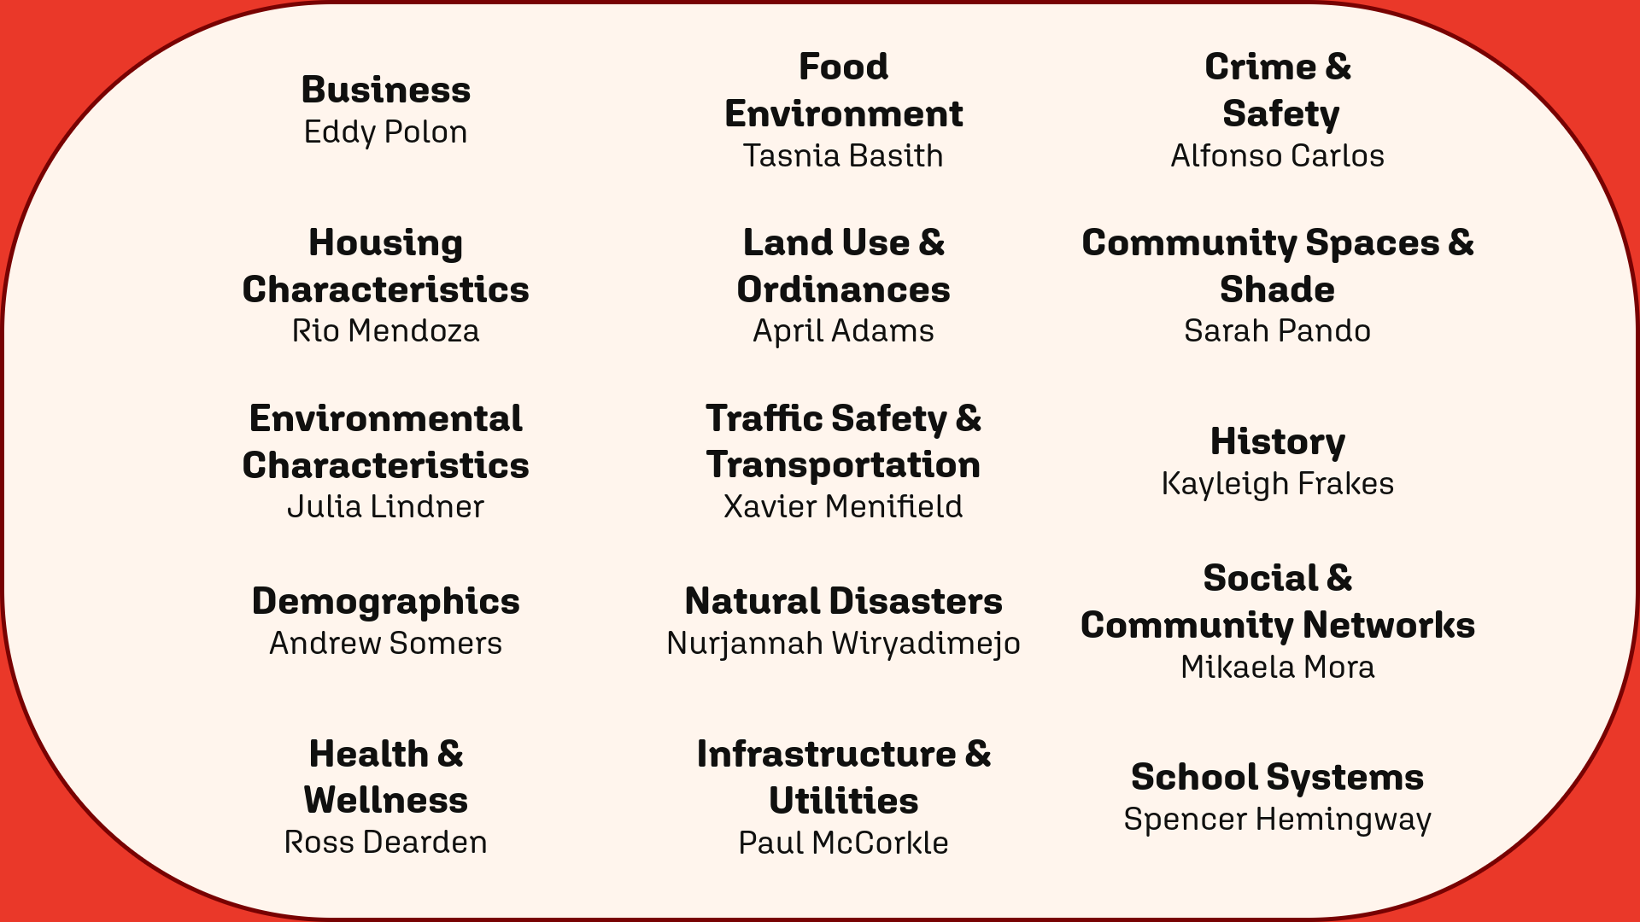
Resilience Indicators
Indicators are individual characteristics of a neighborhood. 14 indicators will be studied for this project.

Slide 7
Project Timeline
Phase 1
Preliminary indicator research
Community outreach
Conduct expert interviews
Phase 2
Incorporate community input
Conduct a community survey
Finalize research
Phase 3
More community outreach & surveys!
Prepare recommendations
Finalize and edit plan
Fall Semester
(August - Mid September)
Fall Semester
(Mid September - December)
Spring Semester
(Mid January - May)

Slide 8
Partnering With You
We want to hear from you!
Goal: A collaborative and participatory planning process
A community plan is only as good as its residential involvement
Our expertise is limited to our lived experiences
How to get involved:
  Attend outreach events
  Survey participation
  Community contacts
  Active VNNC involvement
  Provide feedback on project progression
  Stay in contact with us!

Slide 9

Contact Information
General Questions
  resilientvannuys@gmail.com
Project Updates (Instagram & Facebook)
  @csun.resilientvannuys
Graduate Advisor
  Mintesnot Woldeamanuel, mintesnot.woldeamanuel@csun.edu

Slide 10
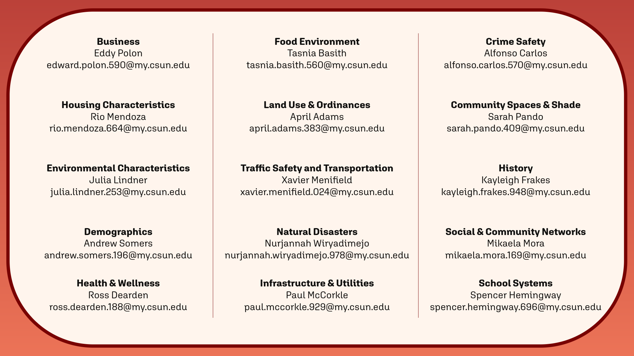

Slide 11
Questions? Comments?

