Slide 1
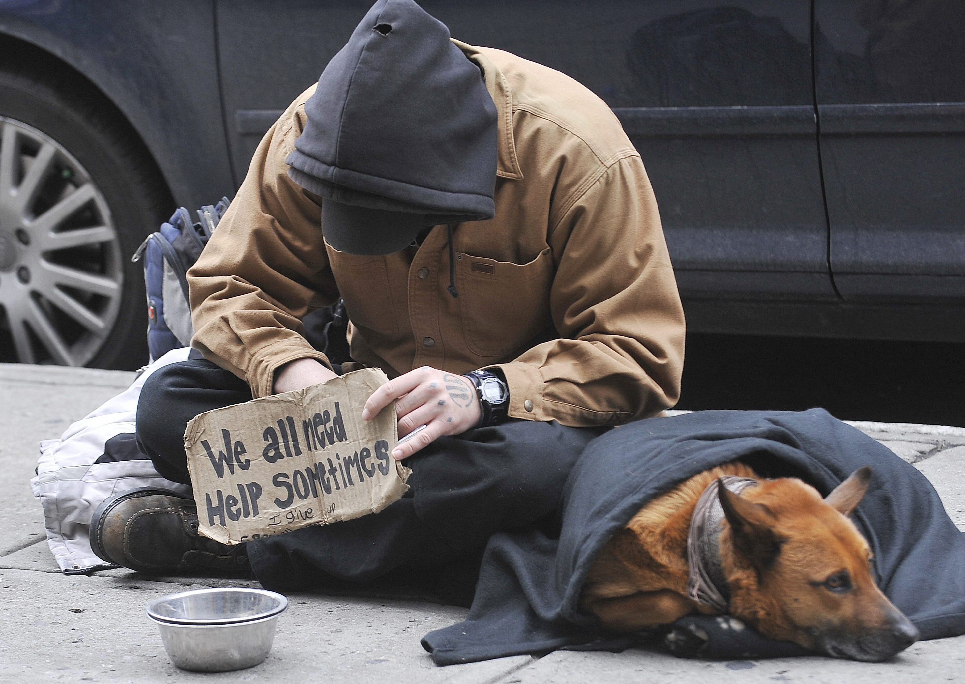
Human Services Committee Community Forum on Homelessness March 2, 2022 (Draft)

Slide 2
Spanish Audio Translation
Zoom
• Spanish translation available
• Click interpretation
• Select language
• Note: must listen to audio/VoIP through your device online

Slide 3
Agenda
Welcome & Introductions

Slide 4
Elected Officials/ Representatives
LAHSA – Corrine
CD4 – Alex
CD6 – Jonah
LA Family Housing - TBD
Hope of the Valley - TBD
LAPD -

Slide 5
Why Are We Here Today?
Graphic with Point in Time Count - TBD

Slide 6
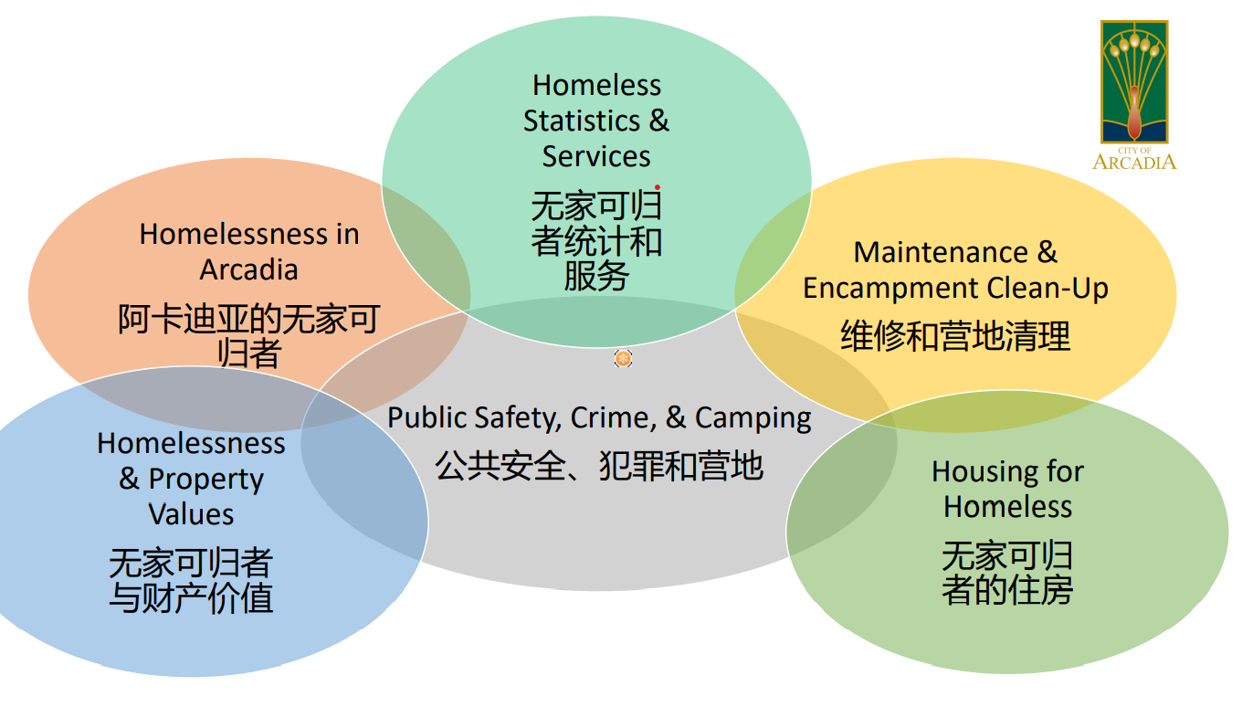

Slide 7
Topics
Homeless Statistics and Services
Homelessness in Van Nuys
Maintenance & Encampment Cleanup
Public Safety, Crime & Camping
Housing for Homeless
Homelessness & Property Values
Renting & Affordable Housing

Slide 8
Topics
Dealing with Homeless encampments
Resources for affordable housing
How rent control works
Budget for homeless services in Van Nuys and LA County
Resources for Homelessness and mental wellness
Where to find employment & Housing opportunities
Outreach strategy. Best practices document.
Issue on the ballot to produce housing who are renters at home. Coalition spearheaded by the United Way
Types of Housing available. List of Bridge Home & project home site.
Project Room Key
Pro Bono Law Library

Slide 9
Discussion: What should Van Nuys do to address homelessness?

