Slide 1
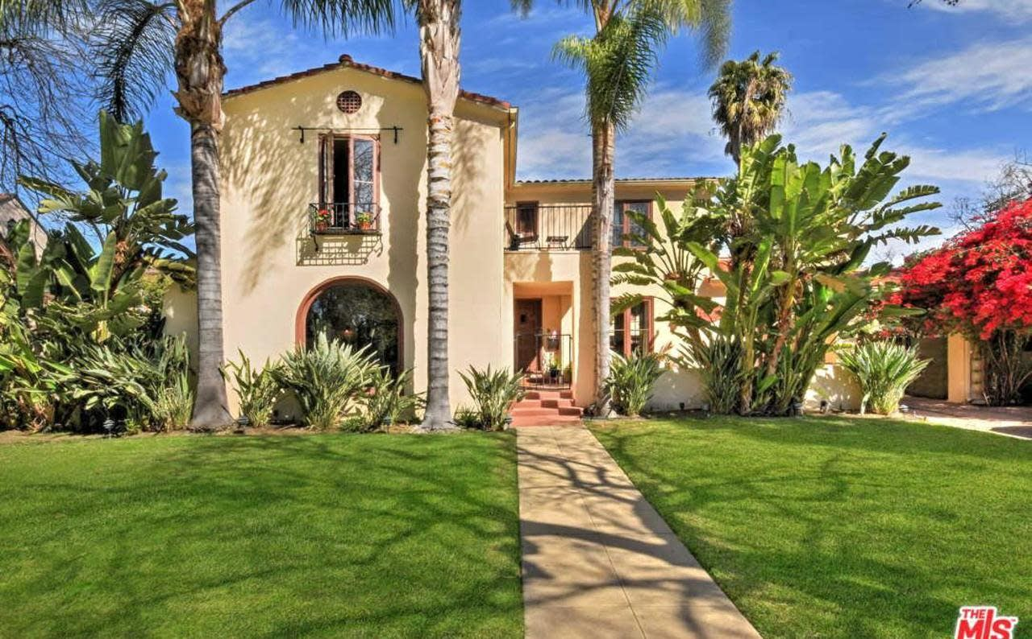
Historic Hatterschied Estate

Slide 2
The home at 14535 Killion St. is a unique Spanish Colonial gem! THERE IS NO OTHER HOME LIKE IT IN VAN NUYS. It features 5 bedrooms and 2 baths. It was built by Bert LaPlante for a prominent banker Hugo C. Hatterschied whose associates were important historical figures, Mr. Isaac Van Nuys, Mr. Lankershim, Mr. Whitsett, Mr. Willis and Mr. Weddington. Mr. Hatterschied was one of the founders of the First Bank of Van Nuys which is located on Van Nuys Blvd. where the Country General Store is now, and is directly across from the Marvin Braude Bldg. He worked at and founded other banks. This is the most spectacular home in the neighborhood and it is in pristine immaculate condition. It is located in what was called Bliss Park, a very upscale area in Van Nuys. Bliss Park is 20 acres and extends from Burbank Blvd. to Albers Street and from Van Nuys Blvd. to Cedros. It featured beautiful orchards and gardens. The previous owners had spent over $100,000 in restoring and maintaining the home and they turned down many prospective buyers who were developers. Somehow it was bought by a developer who is threatening the home with demolition. This would be a tragedy. Van Nuys is a relatively young city. See this city with fresh eyes, as a living museum with architectural gems that provide tangible evidence of our history and a connection to those who came before. Please add your name to the nomination of this unique historical gem.

